Slide 1
Organization Visiting
Brain Station-23
Course Name: Business Studies For Engineers
Course Code: BUS 405
Supervised By
Mr. Md. Iftekharul Amin
Assistant Professor
Institute of Business Administration
University Of Dhaka

Slide 2
Presented By
Group-6
Chinmoy Acharjee BSSE 0819
Sumaya Akther Shammee BSSE 0821
Khayrul Islam Olife BSSE 0822

Slide 3
Presentation Outline
Aim of the visit
About the Organization
Office Description
Hierarchical Structure
Recruitment System
Culture of Organization

Slide 4
Aim Of The Visit
To study the organizational culture
Know about the structure of an organization
Get an idea about the relationship between manager and employees
Know about environment of an organization

Slide 5
About The Organization: Brain Station-23
A globally leading one of the best software development companies in Bangladesh.
Started its journey in 2006.
Was initiated with outsourcing the product into the global market.

Slide 6
Vision And Values: Brain Station-23
Vision : To become an internationally respected information technology company providing best in class solutions based on network, assets and people.
Values:
Integrity and Transparency
Ownership
Passionate about work
Excellence

Slide 7
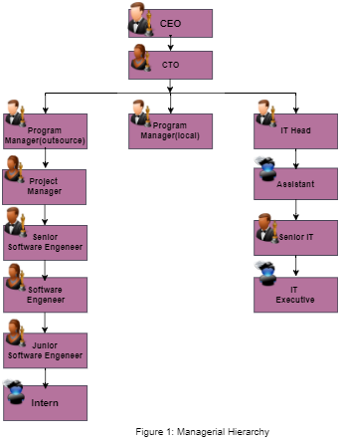
Hierarchical Structure: Brain Station -23

Slide 8
Office Description
Address: 8th floor, Plot#2, Amtali,
Bir Uttam AK Khandakar RD
Mohakhali Commercial Area,
Dhaka-1212

Slide 9
Recruitment System: Brain Station-23
Junior Software Engineer:
Company asks for CV from candidates
Makes short list of CV based on marks and basic test
Takes a written test
Takes interview based on written test result
Sends offer letter to the selected candidates

Slide 10
Recruitment System: Brain Station-23
Software Engineer:
Asks cv from candidate
Makes short list of CV based on marks and basic test
Takes interview
Sends offer letter

Slide 11
Orienting New Employees
Introduce the new employee to other members of immediate staff and other key department members.
Provide information on obtaining a ID card and parking permit.
Provide general orientation to office and departmental policies and procedures.
Provide organisational overview
Include topics relevant to the employee’s department.

Slide 12
Culture Of The Organization
All activities are performed with compliance in mind i.e. compliance with local and international regulations
Expressing gratitude for work done is highly encouraged
Credit and ownership is always given to innovative ideas
Employees with innovative ideas are assigned leading roles in transforming their ideas into reality

Slide 13
Culture Of The Organization
Practice multitasking to a great extent
Weekly two days off
Daily 9 am to 5 pm working hours
Transparent and respectful to others.
All tasks must be approved by the project manager.

Slide 14
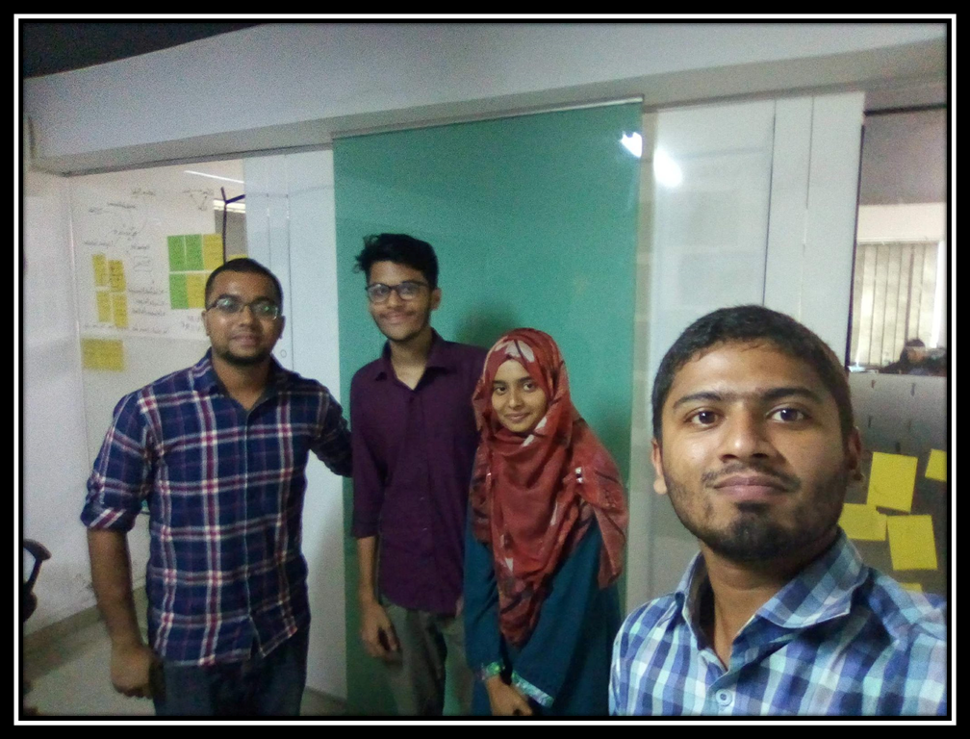

Slide 15
Thank You :)

